Slide 1





Jira-AzureDevops
&
Jira-GitLab
55 Shuman Blvd, Suite 275, Naperville, IL 60563 Tel: +1.630.355.6292 | Email: info@royalcyber.com

Slide 2

Jira-AzureDevops Integration

Slide 3
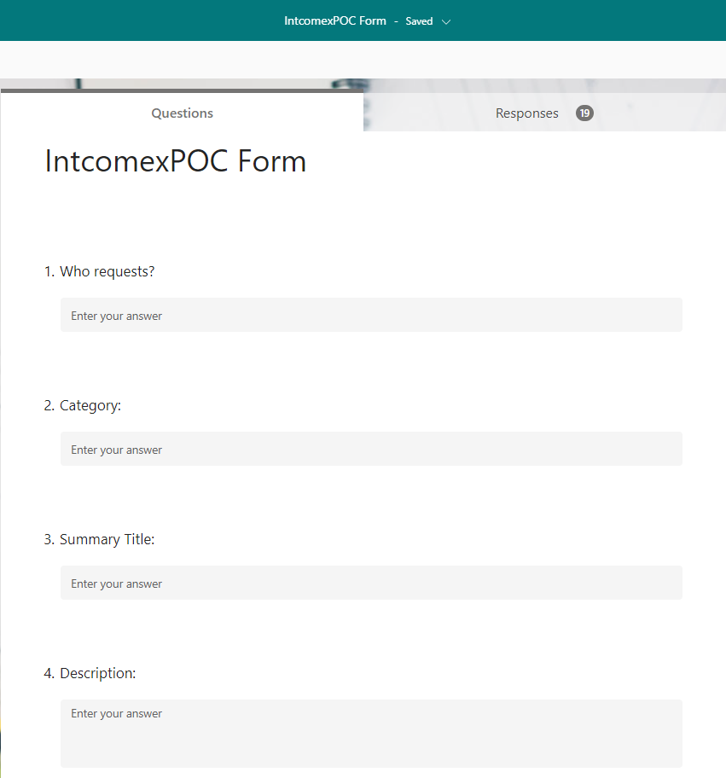
Take a microsoft form for intake response
Add required fields for Microsoft forms
Fill the form
Submit the response

Slide 4
PowerAutomate flows Jira-AzureDevops
Create an issue in Jira after the form is submitted and after the approval of Jira Issue, flow creates an epic in Azure Devops.
Recurrence flow, for the issues which are yet to approve.
When epic is updated in AzureDevops, flow updates Jira issue.

Slide 5
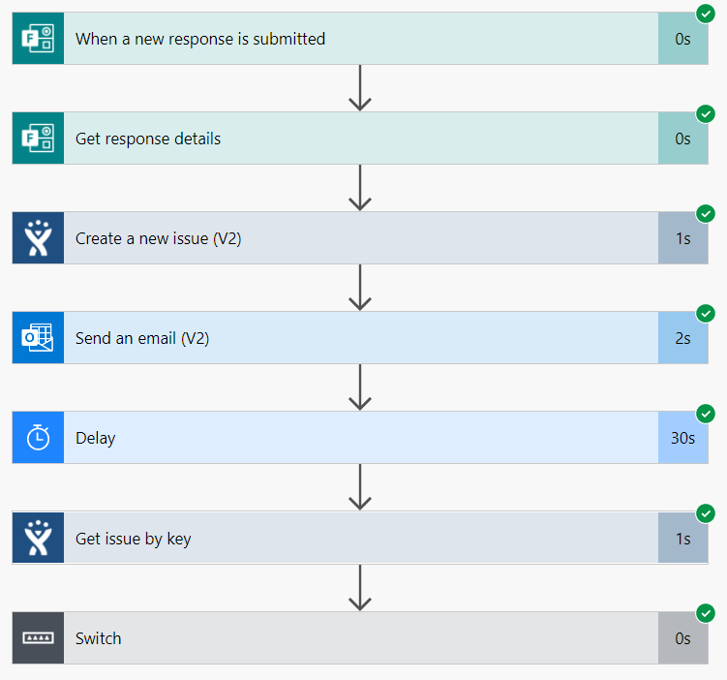
When a new response is submitted, the flow will create an issue in Jira.
It will send an email for approval.
It delays the flow for scheduled time and after the approval, flow will create an epic in AzureDevops.

Slide 6
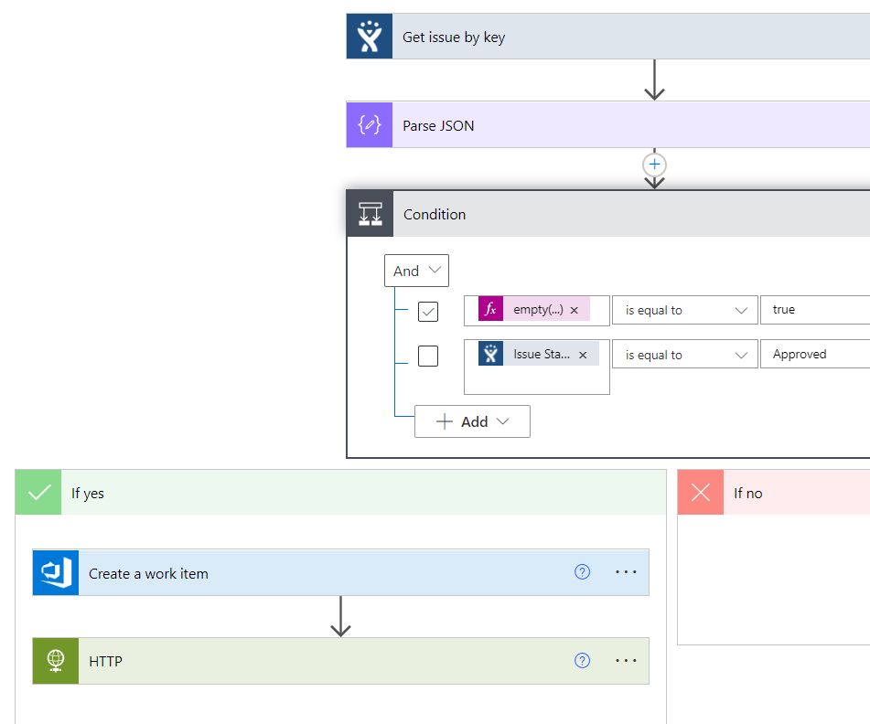
Recurrence Flow Jira-AzureDevops
The flow will run for scheduled intervals and checks whether any issue is updated.
If the issue is approved and it will create an epic in Azure Devops
Updates the epic id in Jira issue.

Slide 7
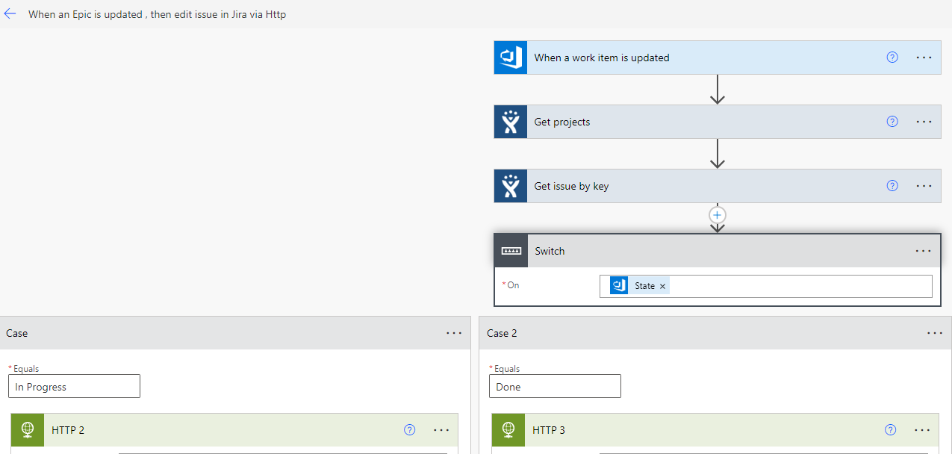
When an Epic is updated, flow edits the issue in Jira
When an epic is updated(the state changes), the flow will edit the status of Jira via http request.

Slide 8
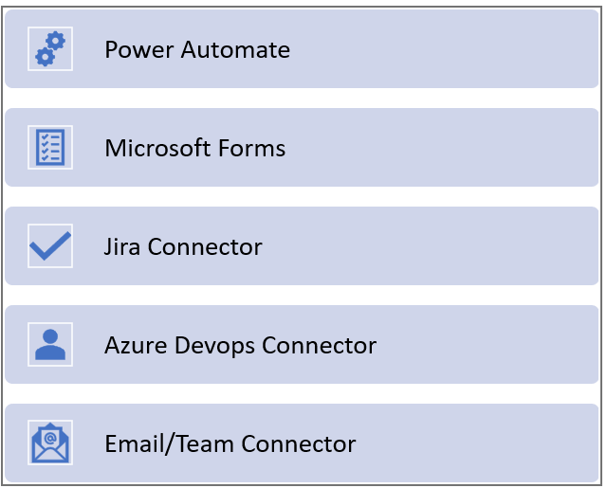
Connectors for Jira-AzureDevops Integration

Slide 9
Jira-GITLAB Integration

Slide 10
Take a microsoft form for intake response
Add required fields for Microsoft forms
Fill the form
Submit the response

Slide 11
PowerAutomate flows Jira-Gitlab
Create an issue in Jira after the form is submitted and after the approval of Jira Issue, flow creates an issue in Gitlab.
Recurrence flow, for the issues which are yet to approve.
When issue is updated in Gitlab, the flow updates Jira issue.

Slide 12
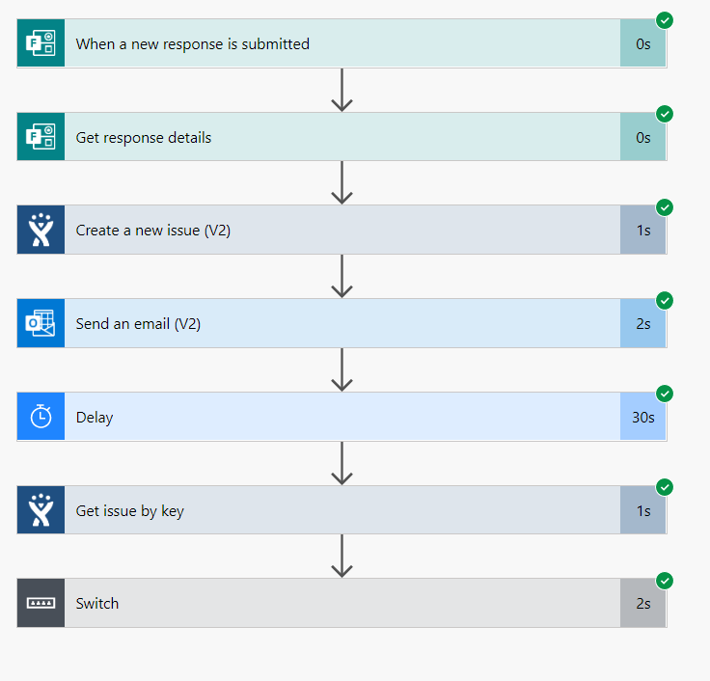
When a new response is submitted, the flow will create an issue in Jira.
It will send an email for approval.
It delays the flow for scheduled time and after the approval, flow will create an issue in Gitlab.

Slide 13
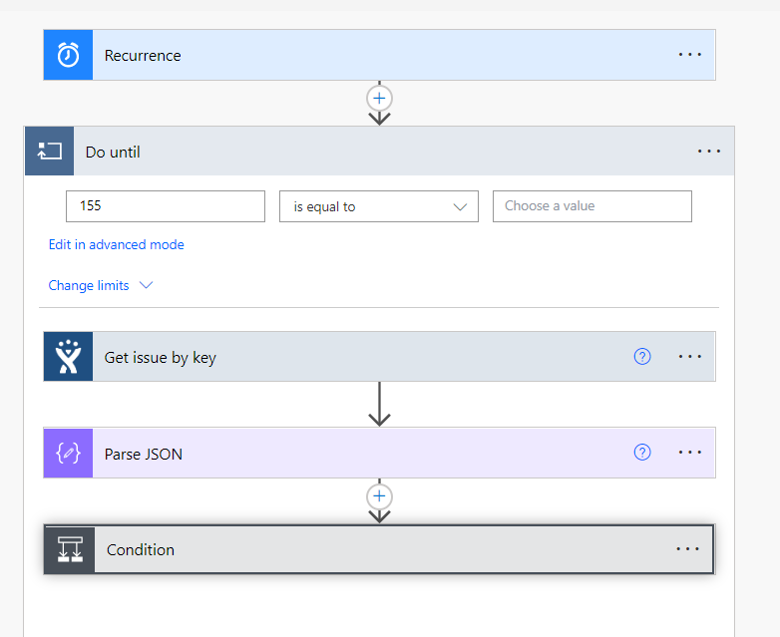
Recurrence Flow Jira-Gitlab
The flow will run for scheduled intervals and checks whether any issue is updated.
If the issue is approved and it will create an issue in Gitlab
Updates the issue id in Jira issue.

Slide 14
When an issue is updated, flow edits the issue in Jira
When an issue is updated(the state changes) in Gitlab, the flow will edit the status of Jira via http request.

Slide 15
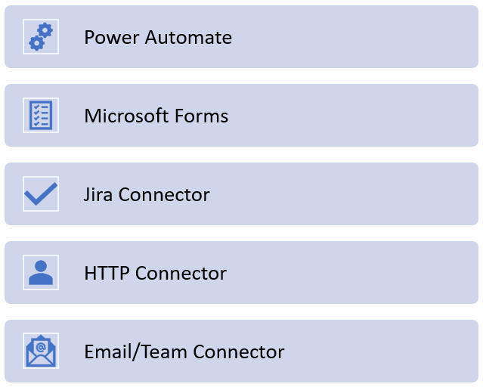
Connectors for Jira-Gitlab Integration

Slide 16
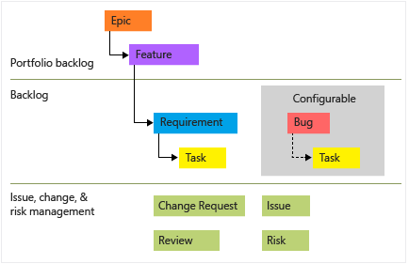
Epics Work-flow
Azure Devops
Gitlab
EPIC
Project1 – issue2
GROUP
Project1-issue1
Project2 – issue1
Tasks
Tasks
Tasks

Slide 17

AzureDevops vs GitLab Features
Features | ADO | GitLab
Supports .Net Applications
In-built connectors for Power Automate
Supports all Stages in a single Yaml file
Creating Custom Fields in Issues
Support and Help Service is High
In Built Security Scanners
Cost for Subscription is Low

